Slide 1
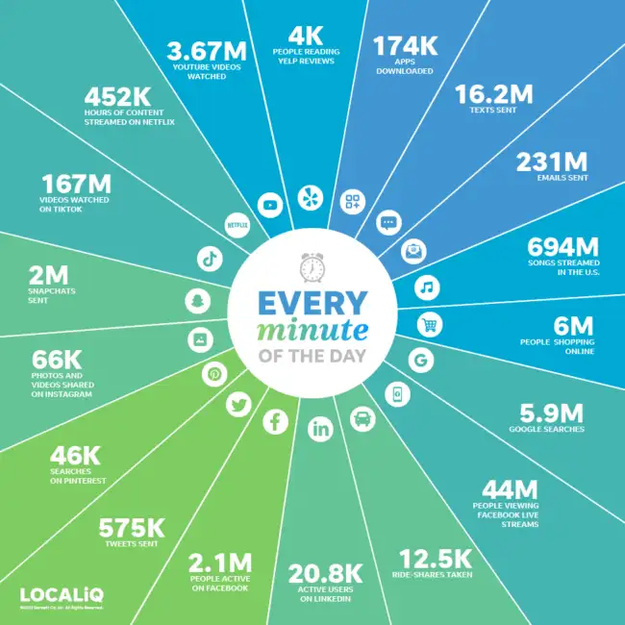
Online Safety Parent Presentation March 2023
Introduction
Risks
Advice

Slide 2
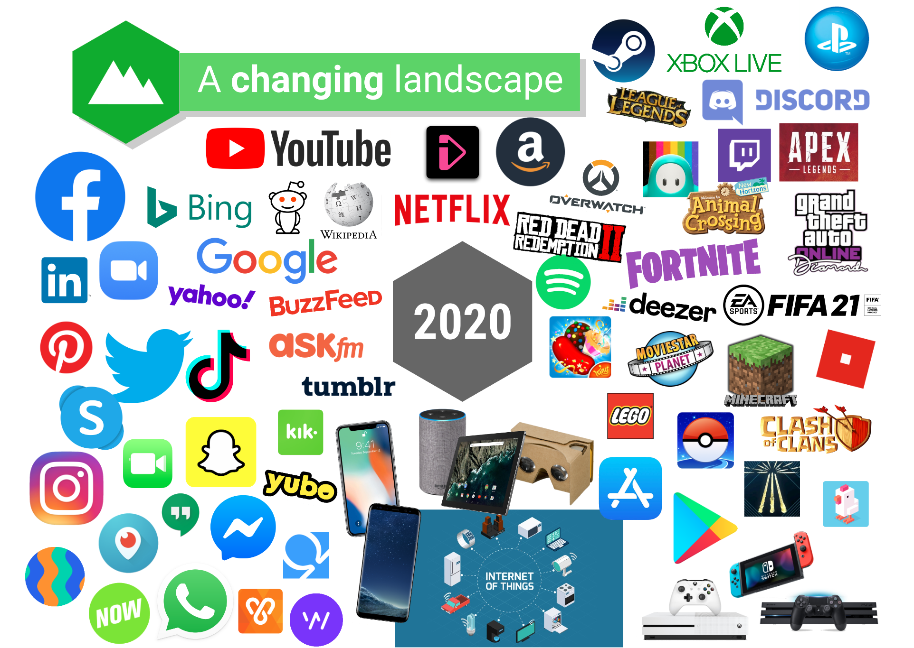

Slide 5
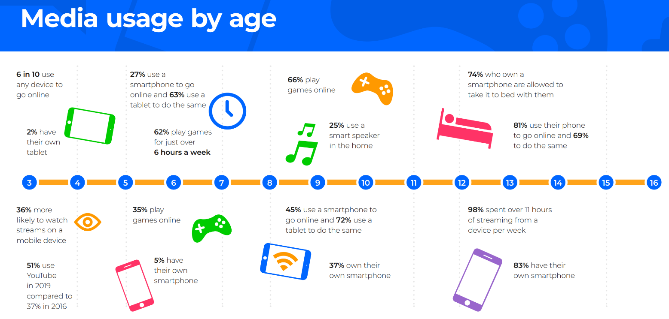

Slide 6
What is a friend? (adult)

Slide 8
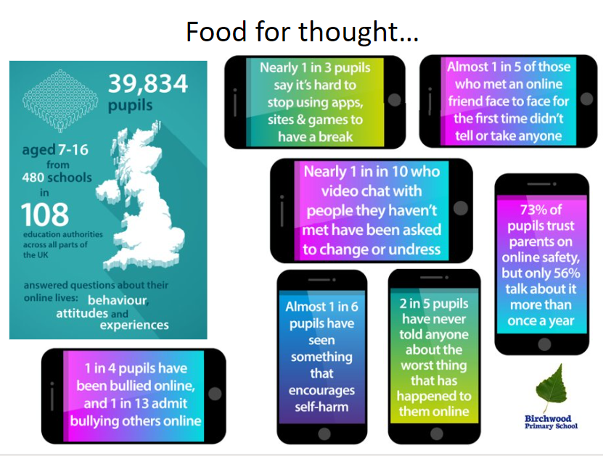

Slide 9
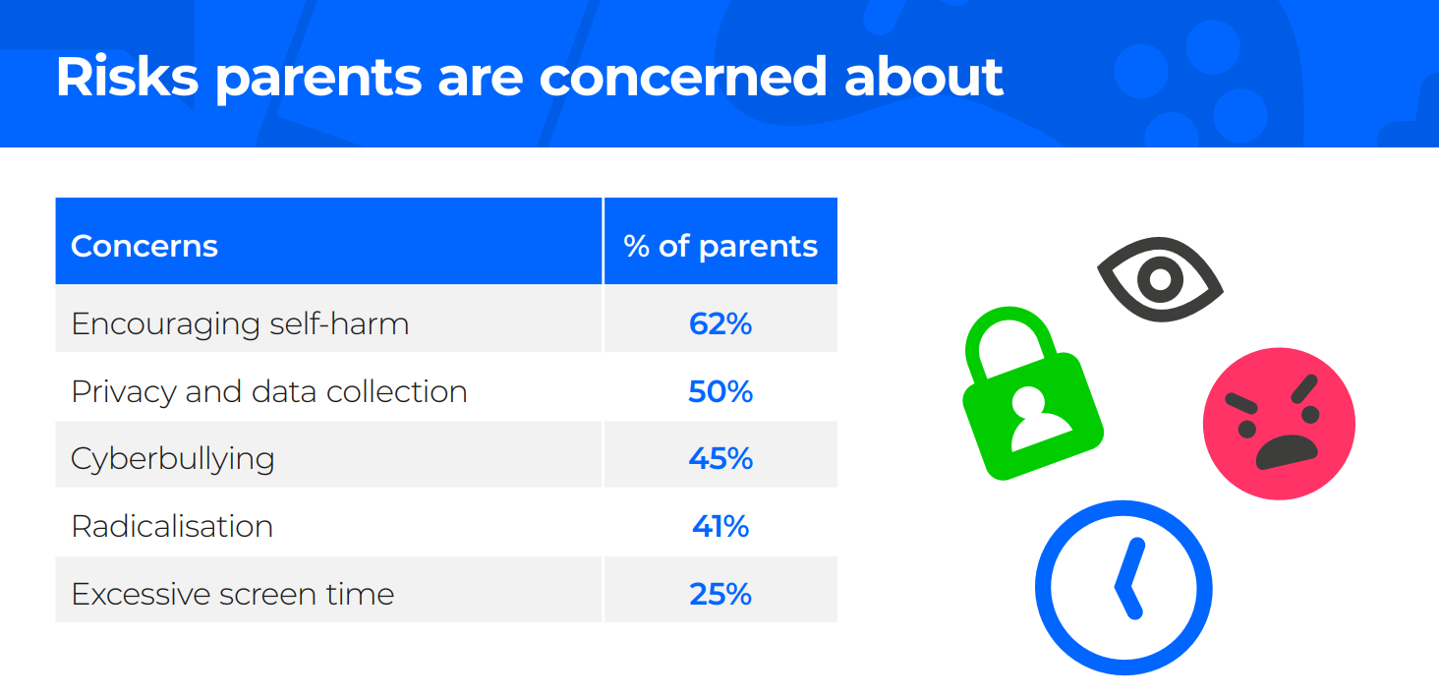

Slide 10
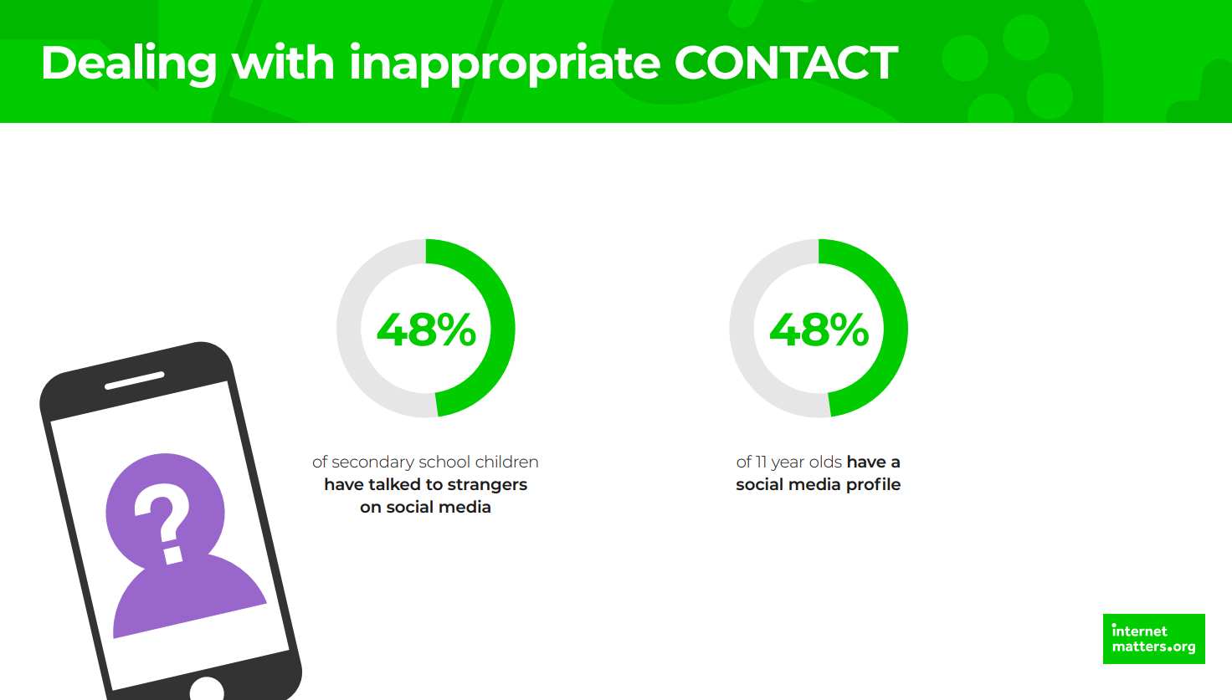

Slide 17
Online Safety Concerns at Staverton

Slide 18
What do we teach in school?

Slide 19
We also embed it across…
‘[Children] learn about healthy relationships and how to keep themselves safe, including when they are online’ Ofsted, July 2022.

Slide 21
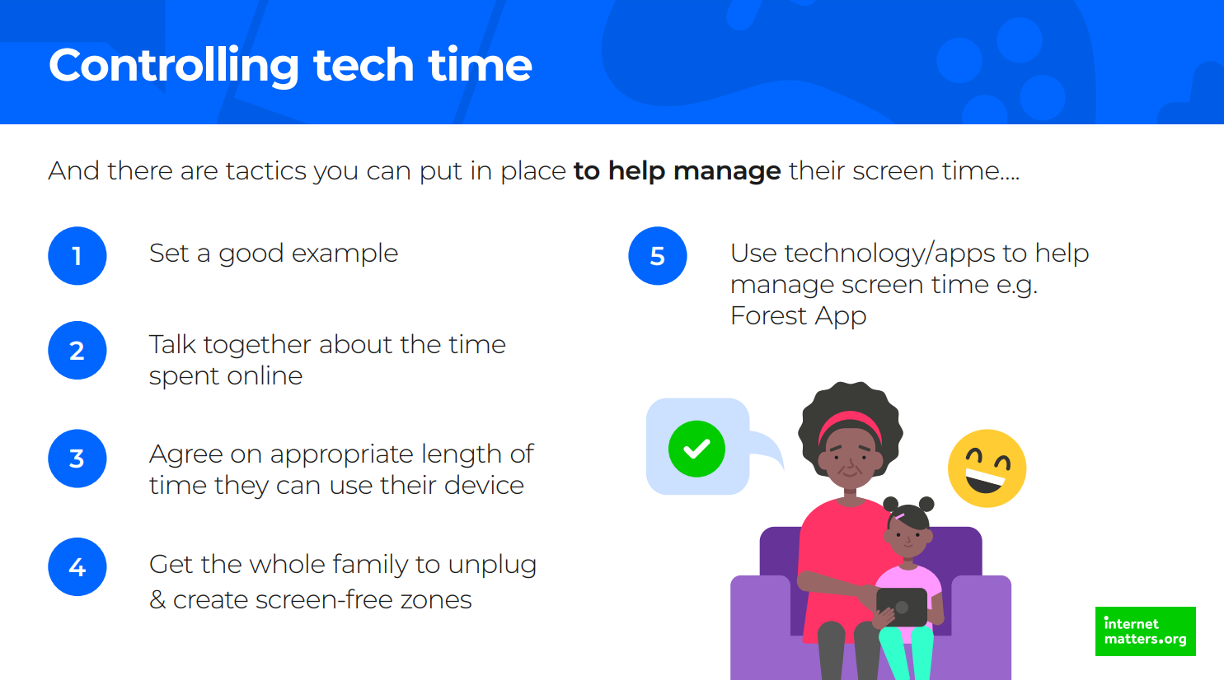

Slide 23
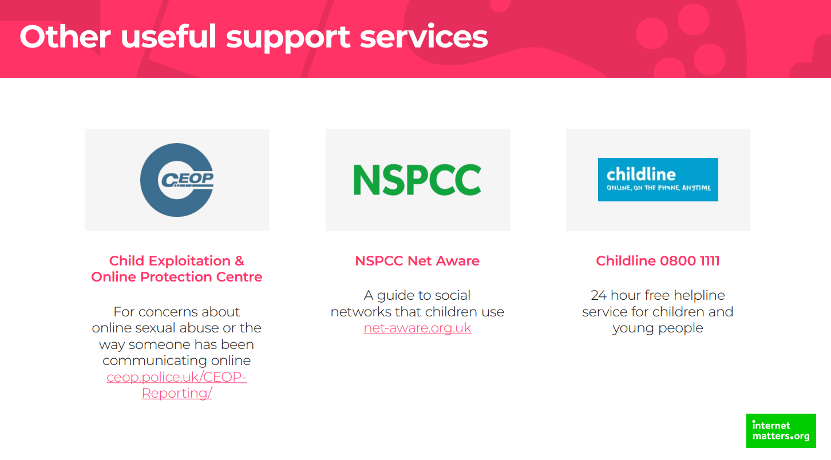

Slide 24
Get involved
Get involved with their favourite games. Learn about the apps, games and devices that they use. Play their favourite games with them, try their favourite apps.
Talk to your children about how they use the internet
Let them know where they can go for help

